Slide 1
Maximum Flow
Maximum Flow Problem
The Ford-Fulkerson method
Maximum bipartite matching

Slide 2
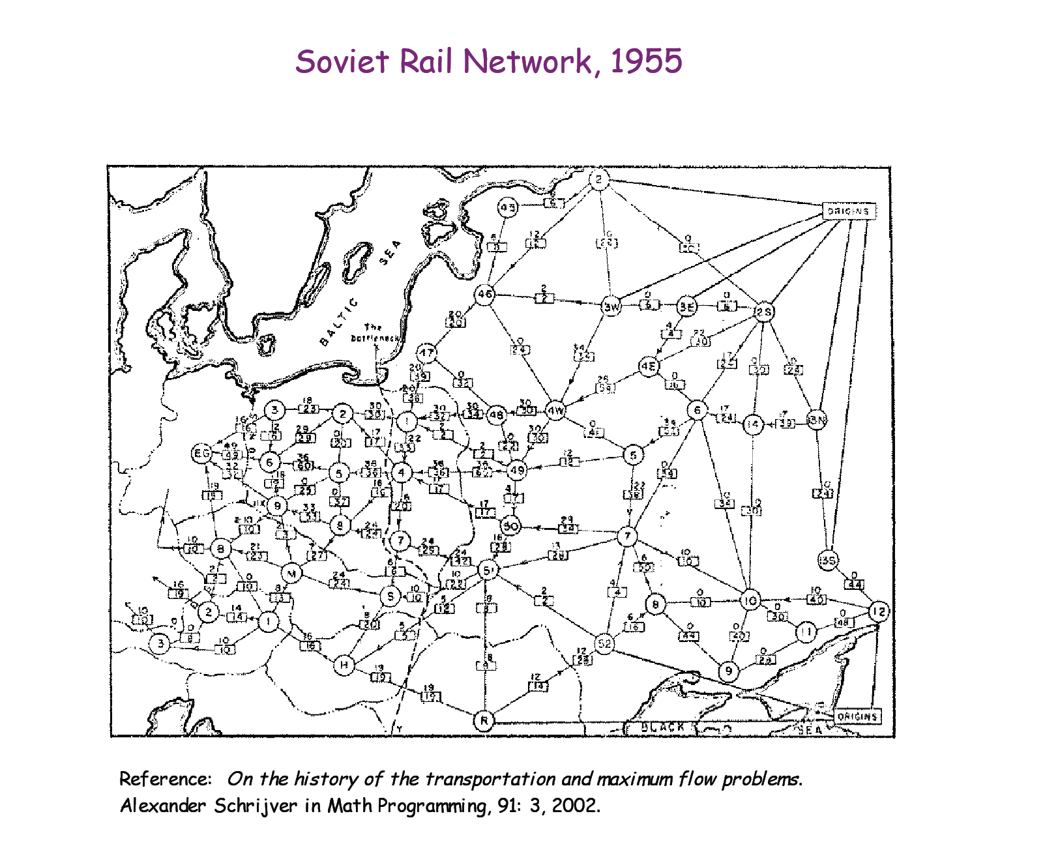
material coursing through a system from a source to a sink

Slide 3
Flow networks:
A flow network G=(V,E): a directed graph, where each edge (u,v)∈E has a nonnegative capacity c(u,v)>=0.
If (u,v)∉E, we assume that c(u,v)=0.
two distinct vertices :a source s and a sink t.
12
16
20
s
10
9
7
t
4
13
4
14

Slide 4
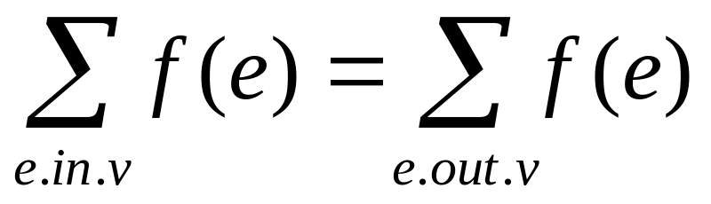
Flow:
G=(V,E): a flow network with capacity function c.
s-- the source and t-- the sink.
A flow in G: a real-valued function f:V*V → R satisfying the following two properties:
Capacity constraint: For all u,v ∈V,
we require f(u,v) ≤ c( u,v).
Flow conservation: For all u ∈V-{s,t}, we require

Slide 5
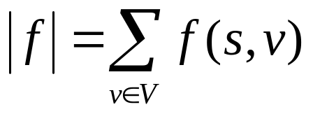
Net flow and value of a flow f:
The quantity f (u,v) is called the net flow from vertex u to vertex v.
The value of a flow is defined as
  The total flow from source to any other vertices.
  The same as the total flow from any vertices to the sink.

Slide 6
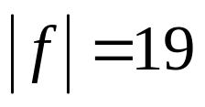
12/12
11/16
15/20
s
10
t
1/4
4/9
7/7
8/13
4/4
11/14
A flow f in G with value .

Slide 7

Maximum-flow problem:
Given a flow network G with source s and sink t
Find a flow of maximum value from s to t.
How to solve it efficiently?

Slide 8
The Ford-Fulkerson method:
This section presents the Ford-Fulkerson method for solving the maximum-flow problem.We call it a “method” rather than an “algorithm” because it encompasses several implementations with different running times.The Ford-Fulkerson method depends on three important ideas that transcend the method and are relevant to many flow algorithms and problems: residual networks,augmenting paths,and cuts. These ideas are essential to the important max-flow min-cut theorem,which characterizes the value of maximum flow in terms of cuts of the flow network.

Slide 9
Continue:
FORD-FULKERSON-METHOD(G,s,t)
initialize flow f to 0
while there exists an augmenting path p
do augment flow f along p
return f

Slide 10
Residual networks:
Given a flow network and a flow, the residual network consists of edges that can admit more net flow.
G=(V,E) --a flow network with source s and sink t
f: a flow in G.
The amount of additional net flow from u to v before exceeding the capacity c(u,v) is the residual capacity of (u,v), given by: c_{f}(u,v)=c(u,v)-f(u,v)
in the other direction: c_{f}(v, u)=c(v, u)+f(u, v).

Slide 11
Example of residual network
12
4/12
v₁
v₃
v₁
v₃
16
20
4/16
20
s
10
4
7
t
s
7
9
10
4
t
4/9
13
4
13
4/4
v₂
v₄
v₂
v₄
14
4/14
(a)

Slide 12
Example of Residual network (continued)
8
12
v₁
v₃
20
4
s
4
4
10
4
t
7
5
13
10
4
v₂
v₄
4
(b)

Slide 13
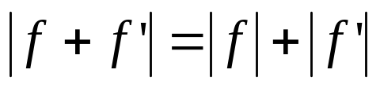
Fact 1:
Let G=(V,E) be a flow network with source s and sink t, and let f be a flow in G.
Let G_{f} be the residual network of G induced by f,and let f’ be a flow in G_{f}.Then, the flow sum f+f’ is a flow in G with value .
f+f’: the flow in the same direction will be added.
the flow in different directions will be cnacelled.

Slide 14
Augmenting paths:
Given a flow network G=(V,E) and a flow f, an augmenting path is a simple path from s to t in the residual network G_{f}.
Residual capacity of p : the maximum amount of net flow that we can ship along the edges of an augmenting path p, i.e., c_{f}(p)=min{c_{f}(u,v):(u,v) is on p}.
2
3
1
The residual capacity is 1.

Slide 15
Example of an augment path (bold edges)
8
12
v₁
v₃
20
4
s
4
4
10
4
t
7
5
13
10
4
v₂
v₄
4
(b)

Slide 16

The basic Ford-Fulkerson algorithm:
FORD-FULKERSON(G,s,t)
for each edge (u,v) ∈E[G]
do f[u,v] 0
f[v,u] 0
while there exists a path p from s to t in the residual network G_{f}
do c_{f}(p) min{c_{f}(u,v): (u,v) is in p}
for each edge (u,v) in p
do f[u,v] f[u,v]+c_{f}(p)

Slide 17
Example:
The execution of the basic Ford-Fulkerson algorithm.
(a)-(d) Successive iterations of the while loop: The left side of each part shows the residual network G_{f} from line 4 with a shaded augmenting path p.The right side of each part shows the new flow f that results from adding f_{p} to f.The residual network in (a) is the input network G.(e) The residual network at the last while loop test.It has no augmenting paths,and the flow f shown in (d) is therefore a maximum flow.

Slide 18
12
4/12
v₁
v₃
v₁
v₃
16
20
4/16
20
s
10
4
7
t
s
7
9
10
4
t
4/9
13
4
13
4/4
v₂
v₄
v₂
v₄
14
4/14
(a)

Slide 19
8
12
4/12
v₁
v₃
v₁
v₃
20
7/20
4
11/16
s
4
4
10
4
t
s
4
7/7
t
7
7/10
4/9
5
13
10
4
13
4/4
v₂
v₄
v₂
v₄
4
11/14
(b)

Slide 20
8
12/12
5
v₁
v₃
13
v₁
v₃
4
11/16
15/20
11
4
s
3
11
7
7
t
s
7/7
10
1/4
t
5
4/9
13
3
8/13
4/4
v₂
v₄
4
v₂
v₄
11
11/14
(c)

Slide 21
12
12/12
5
v₁
v₃
5
v₁
v₃
11/16
19/20
11
4
s
7
15
t
s
5
11
3
10
1/4
7/7
t
5
9
8
3
12/13
4/4
v₂
v₄
4
v₂
v₄
11
11/14
(d)

Slide 22
12
5
v₁
v₃
1
s
3
7
19
t
1
11
9
12
3
4
v₂
v₄
11
(e)

Slide 23
Time complexity:
If each c(e) is an integer, then time complexity is O(|E|f*), where f* is the maximum flow.
Reason: each time the flow is increased by at least one.
This might not be a polynomial time algorithm since f* can be represented by log (f*) bits. So, the input size might be log(f*).

Slide 24
The Edmonds-Karp algorithm
Find the augmenting path using breadth-first search.
Breadth-first search gives the shortest path for graphs (Assuming the length of each edge is 1.)
Time complexity of Edmonds-Karp algorithm is O(VE²).
The proof is very hard and is not required here.

Slide 25
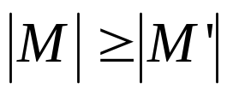
Maximum bipartite matching:
Bipartite graph: a graph (V, E), where V=L∪R, L∩R=empty, and for every (u, v)∈E, u ∈L and v ∈R.
Given an undirected graph G=(V,E), a matching is a subset of edges M⊆E such that for all vertices v∈V,at most one edge of M is incident on v.We say that a vertex v ∈V is matched by matching M if some edge in M is incident on v;otherwise, v is unmatched. A maximum matching is a matching of maximum cardinality,that is, a matching M such that for any matching M’, we have .

Slide 26
L
R
L
R
(a)
(b)
A bipartite graph G=(V,E) with vertex partition V=L∪R.(a)A matching with cardinality 2.(b) A maximum matching with cardinality 3.

Slide 27
Finding a maximum bipartite matching:
We define the corresponding flow network G’=(V’,E’) for the bipartite graph G as follows. Let the source s and sink t be new vertices not in V, and let V’=V∪{s,t}.If the vertex partition of G is V=L ∪R, the directed edges of G’ are given by E’={(s,u):u∈L} ∪{(u,v):u ∈L,v ∈R,and (u,v) ∈E} ∪{(v,t):v ∈R}.Finally, we assign unit capacity to each edge in E’.
We will show that a matching in G corresponds directly to a flow in G’s corresponding flow network G’. We say that a flow f on a flow network G=(V,E) is integer-valued if f(u,v) is an integer for all (u,v) ∈V*V.

Slide 28
s
t
L
R
L
R
(a)
(b)
(a)The bipartite graph G=(V,E) with vertex partition V=L∪R. A
maximum matching is shown by shaded edges.(b) The corresponding
flow network.Each edge has unit capacity.Shaded edges have
a flow of 1,and all other edges carry no flow.

Slide 29
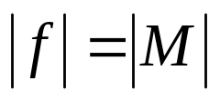
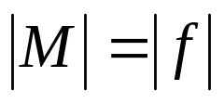
Continue:
Lemma .
Let G=(V,E) be a bipartite graph with vertex partition V=L∪R,and let G’=(V’,E’) be its corresponding flow network.If M is a matching in G, then there is an integer-valued flow f in G’ with value .Conversely, if f is an integer-valued flow in G’,then there is a matching M in G with cardinality .
Reason: The edges incident to s and t ensures this.
  Each node in the first column has in-degree 1
  Each node in the second column has out-degree 1.
  So each node in the bipartite graph can be involved once in the flow.

Slide 30
Example:

Slide 31
Aug. path:

Slide 32
1
1
1
1
1
1
1
Residual network. Red edges are new edges in the residual network. The new aug. path is bold. Green edges are old aug. path. old flow=1.

